Slide 1
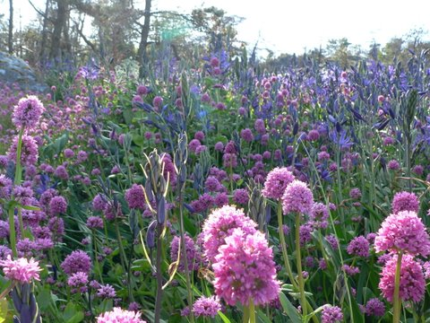

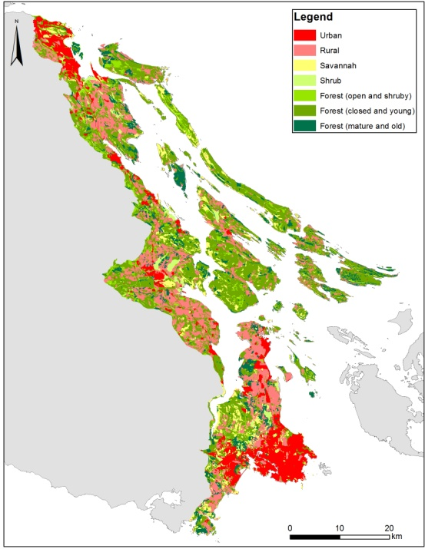
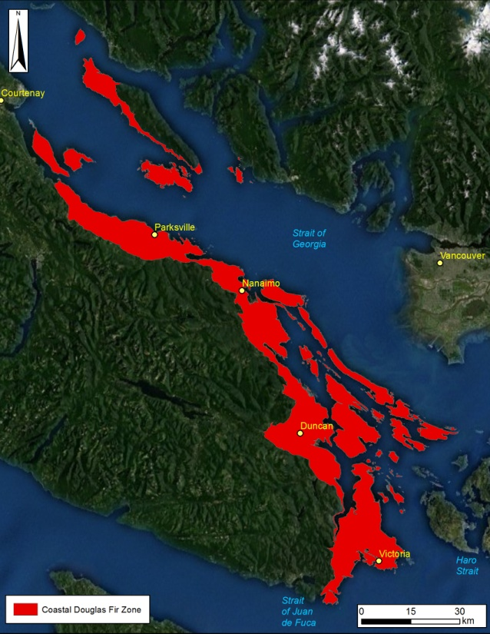
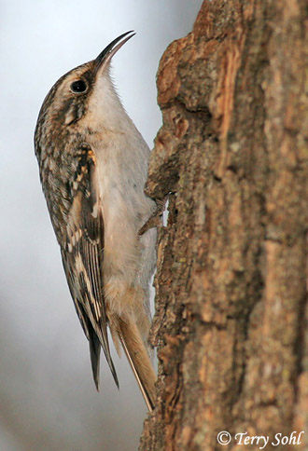
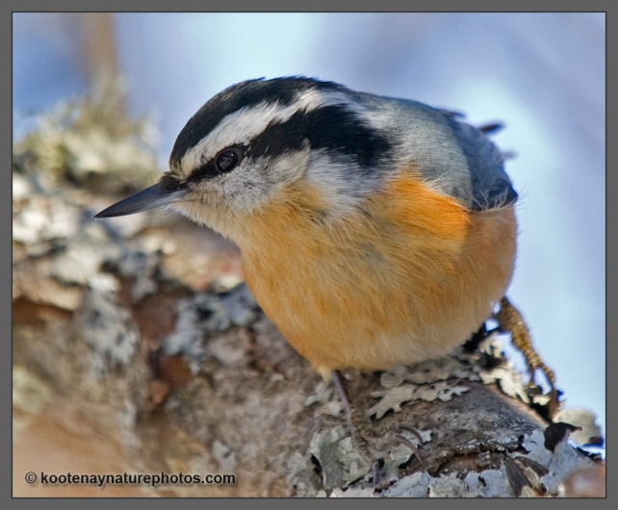
Biodiversity – Carbon Synergy in the Conservation of Forested Land
Richard Schuster
Liber Ero Fellow, Carleton University

Slide 2
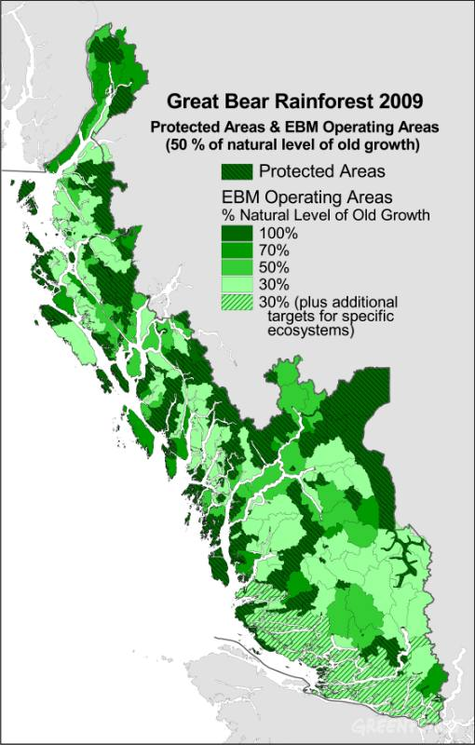
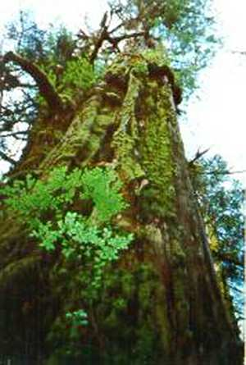
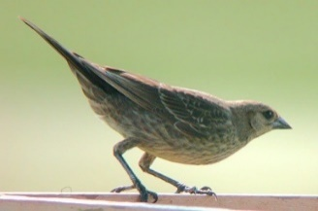
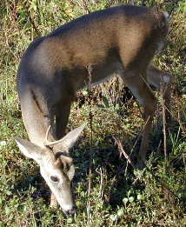
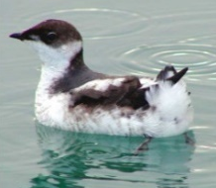
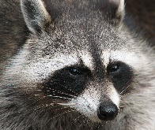
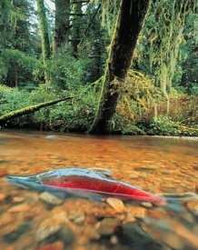
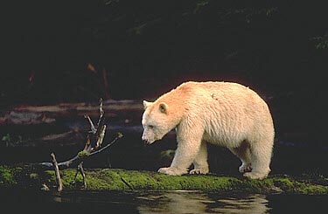
Traditional Goal of Conservation Area Design
Prioritize and Conserve ‘Intact’ or ‘Relic Ecosystems’
Multiple criteria
Decision support tools
Impractical in Human-dominated Landscapes
No Benchmark Ecosystems
Biological Survey Data Often Biased
Many Threats Hard to Map

Slide 3
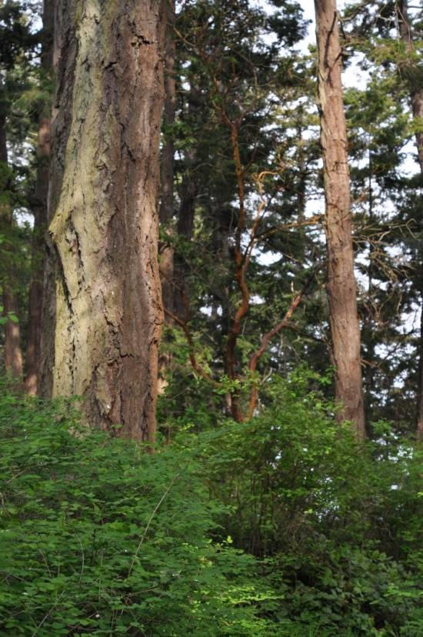
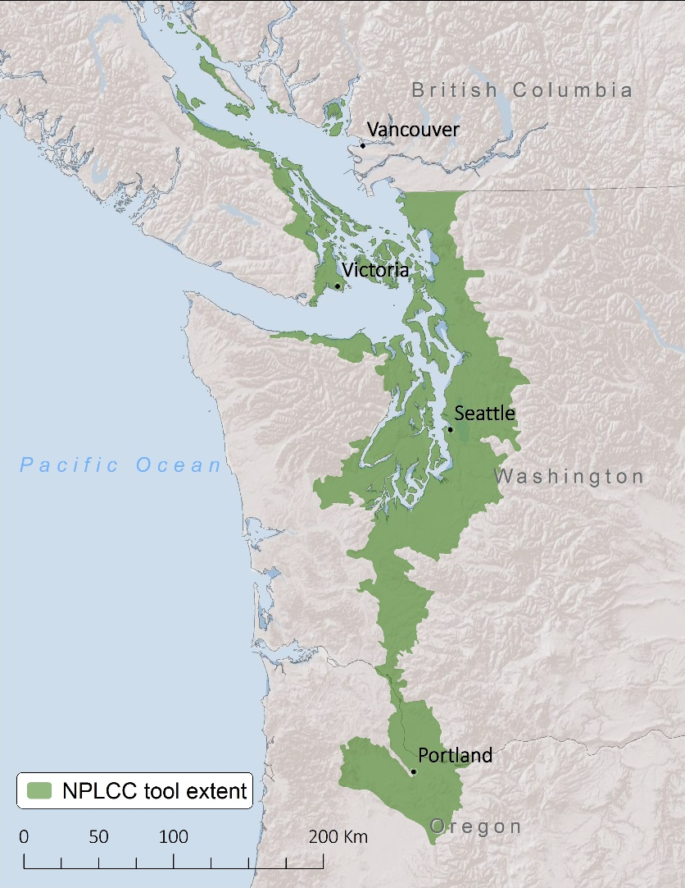
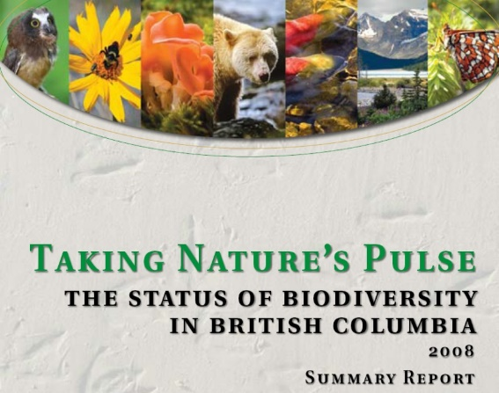
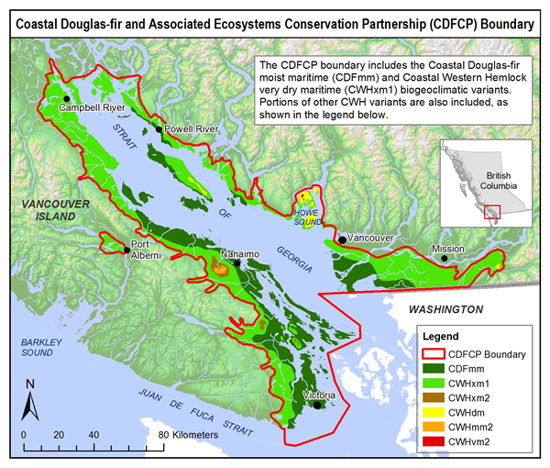
Dry Forest / Savanna Habitats of the Georgia Basin
49% Converted to Human Use
< 3% Pre-settlement Forest Intact
> 80% Privately-owned
>153 Species At Risk
Most Imperiled Ecosystem in BC
Vancouver
And Throughout the Pacific Northwest

Slide 4

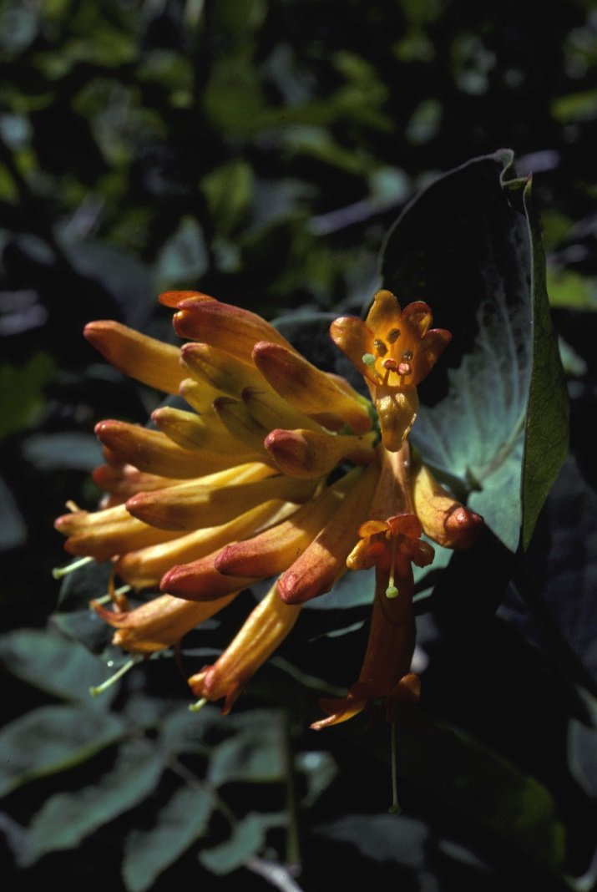
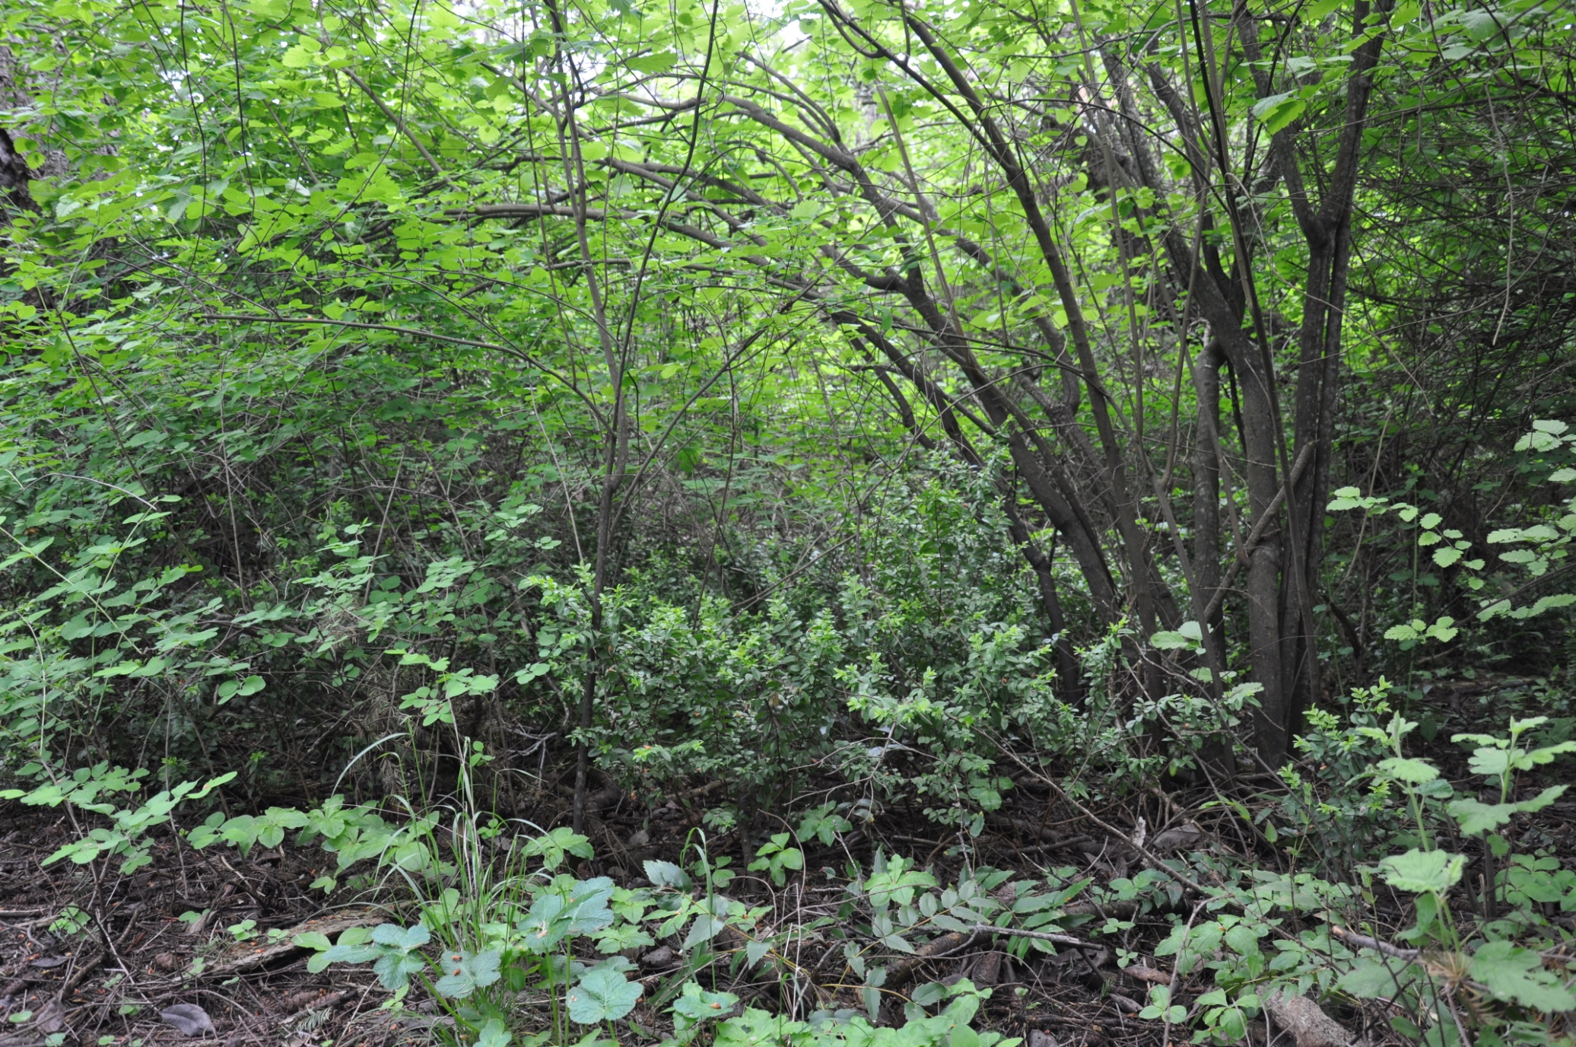
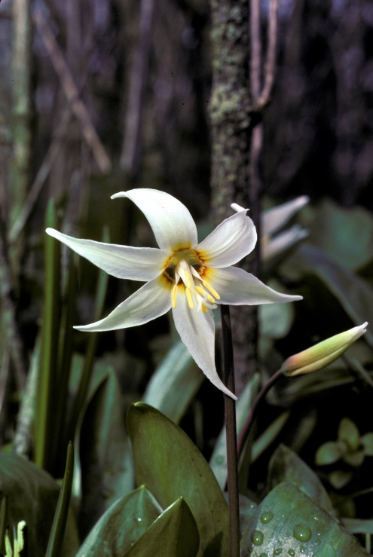
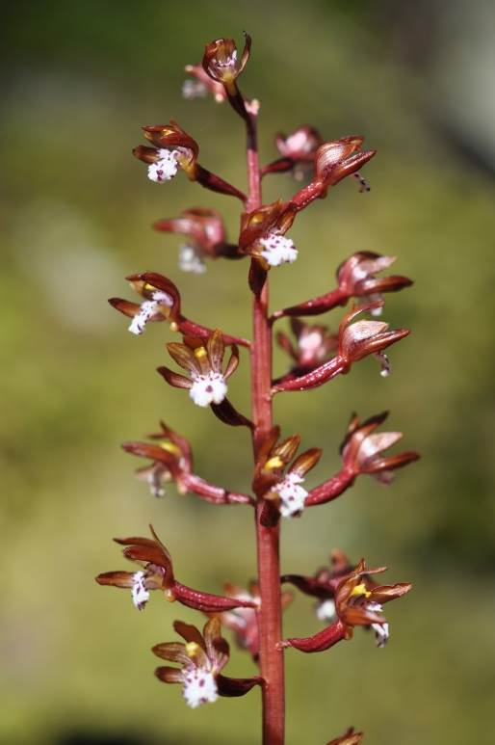
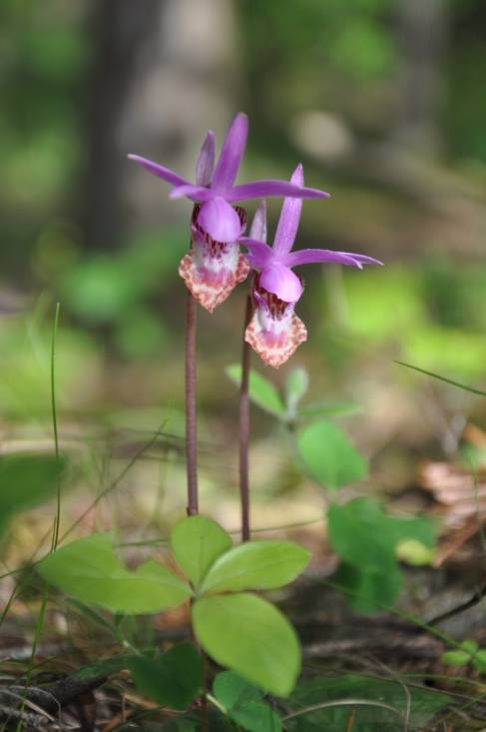
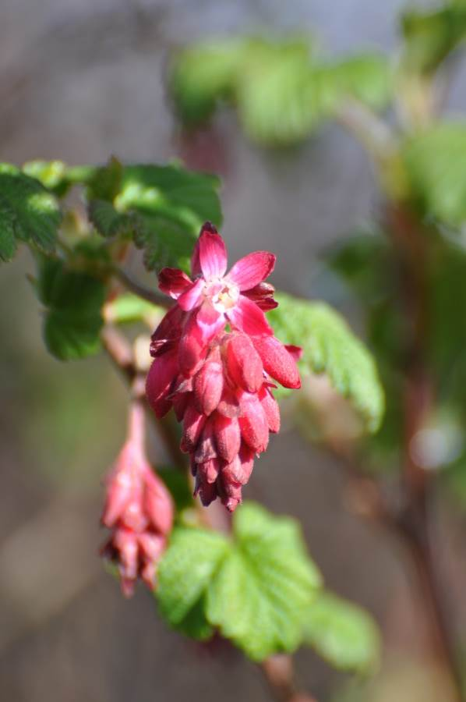
Forested Deep Soil Sites

Slide 5
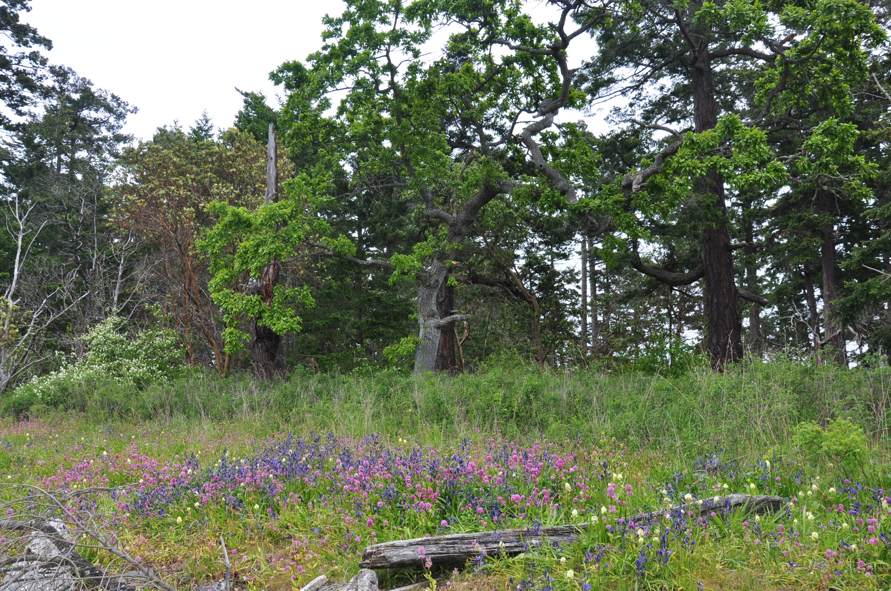
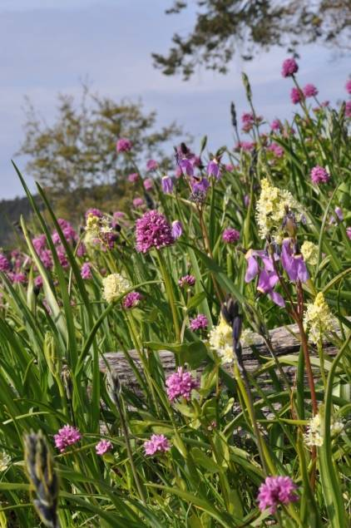
Shallow-soil `Garry Oak` Meadow and Woodland

Slide 6
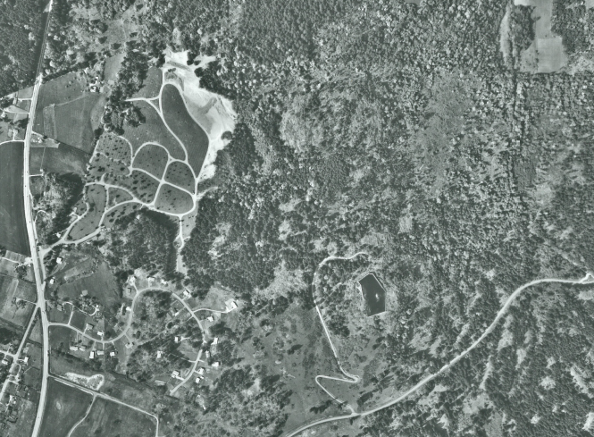
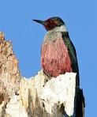
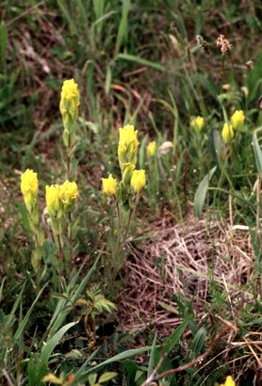
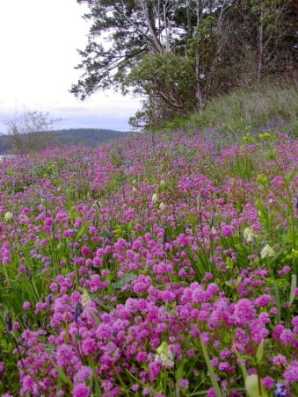
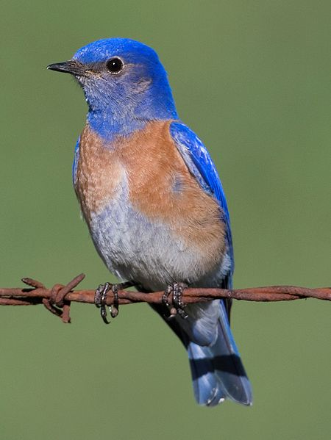
A Human Dominated Landscape
Lewis’s woodpecker
Golden Paintbrush
Royal Oaks, Victoria BC
Royal Oak 1964
Oak meadow
Key Concerns
Habitat loss/Fragmentation
Viability of Small Populations
Exotic Competitors/Predators
Over-abundant Species
Western bluebird

Slide 7
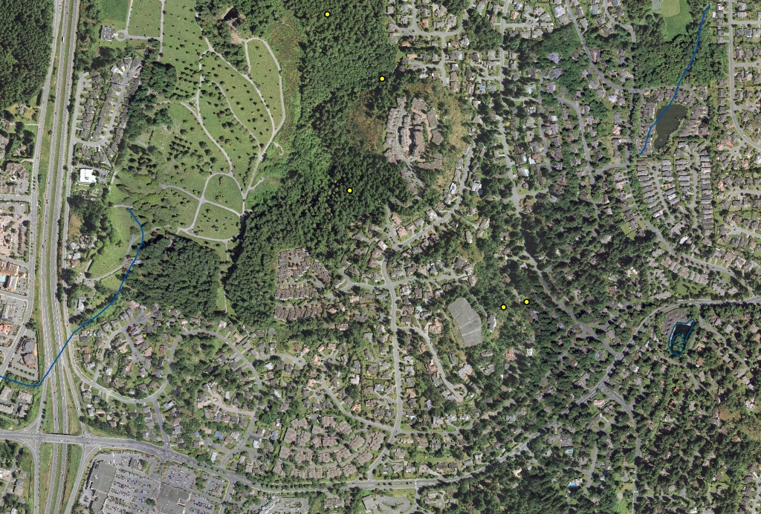
Habitat Loss and Fragmentation
Royal Oaks
Victoria, BC
1964 vs 2005
High Urgency, High Threat
Viability?

Slide 8
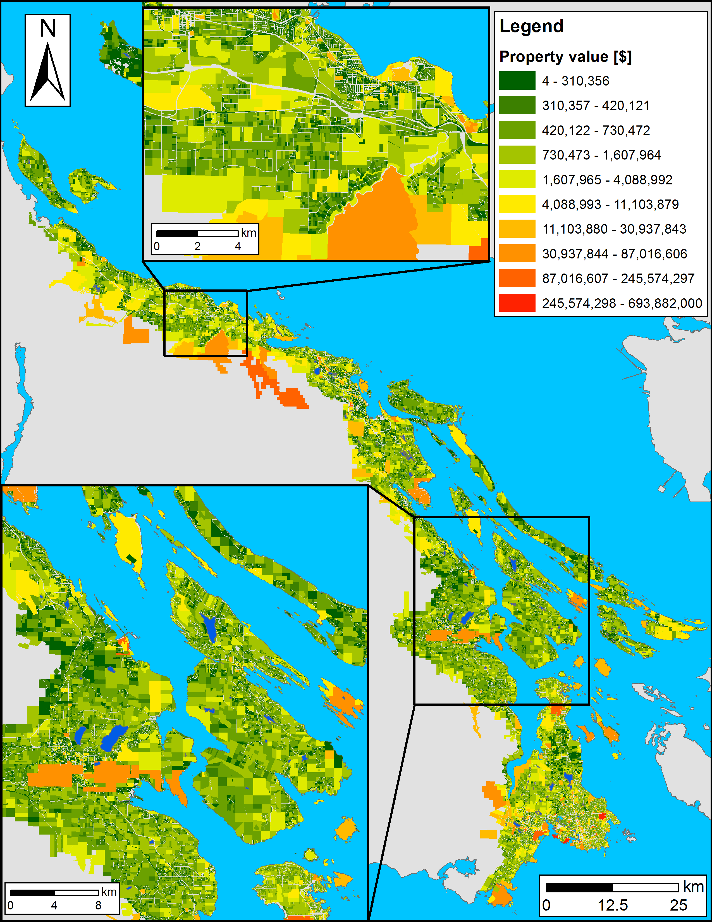
Planning units
Land base of the CDFCP: ~198,000 properties
Possible solutions for a reserve system: 2^198,000 > atoms in the Universe
How to optimize prioritization? prioritzr

Slide 9


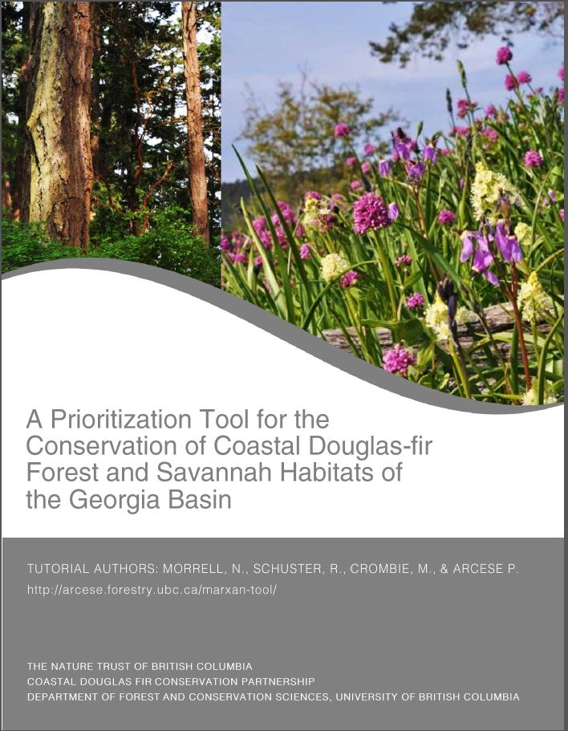
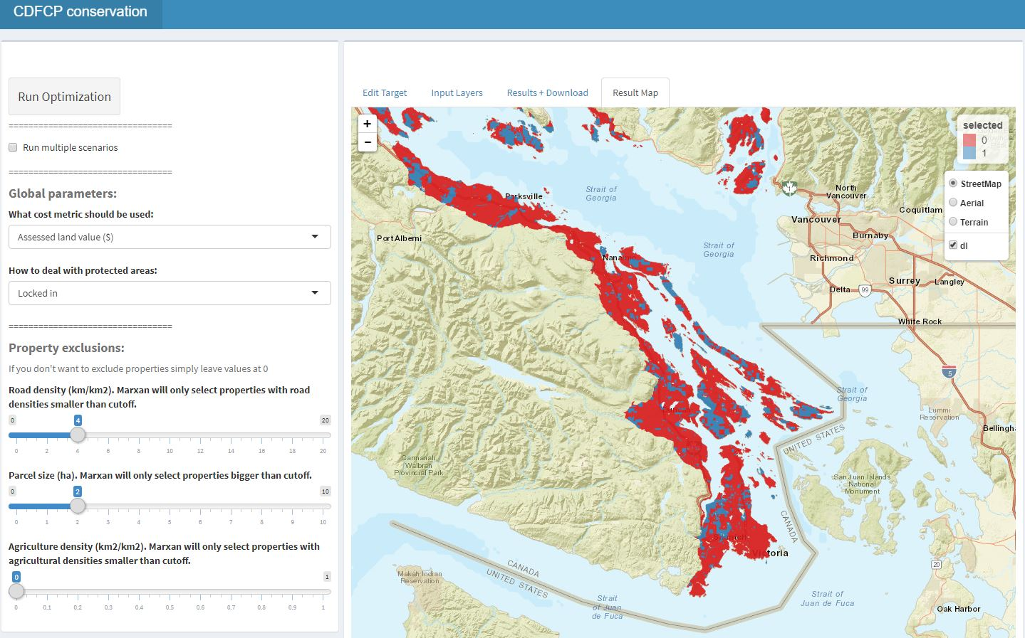
Current tool version

Slide 10
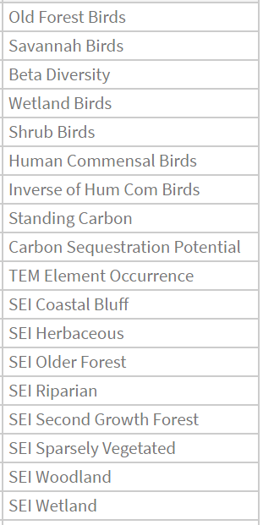
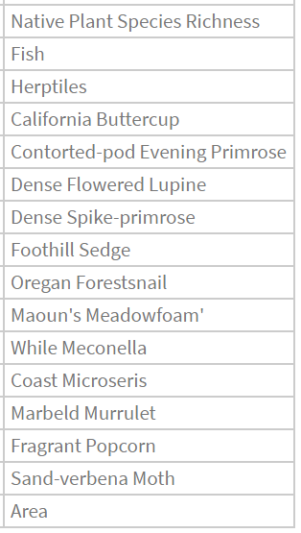

Slide 11
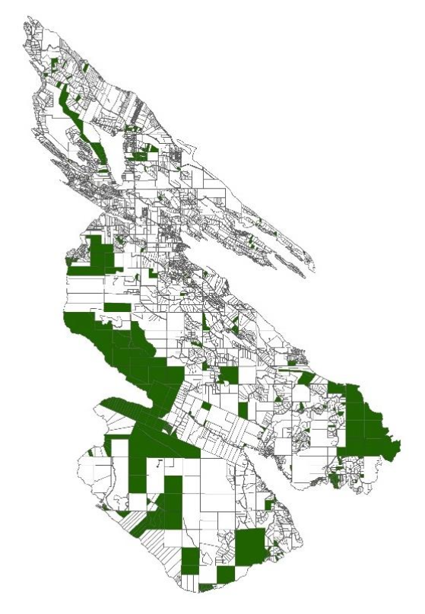

Applications?
Acquire Biodiverse Parcels
Minimize Management Costs, Maximize Return on Conservation Investments
Develop Contact Lists to Engage Private Landowners in Conservation at Landscape Scales

Slide 12
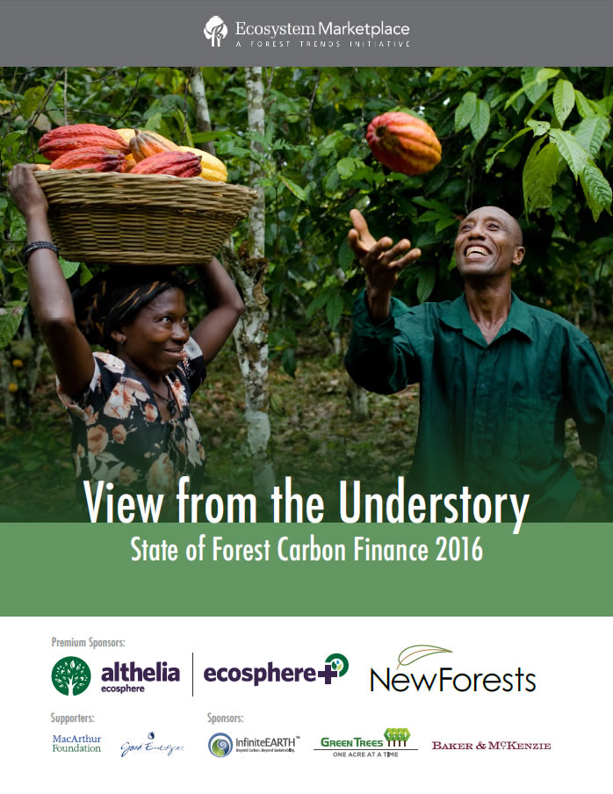
Payments for Ecosystem Services
$6 Billion Invested
to 2016 in Carbon

Slide 13
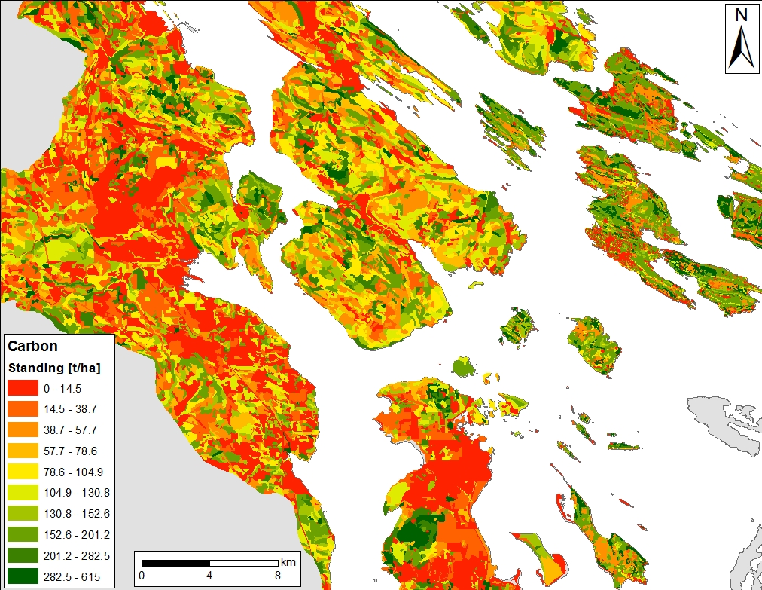
Synergies: High Value Forests Have Standing Carbon In Excess of 200 t/ha
Standing Carbon in High Value Forests in the Georgia Basin is Currently Worth $4-10K/ha
~3-15% of Acquisition Cost

Slide 14
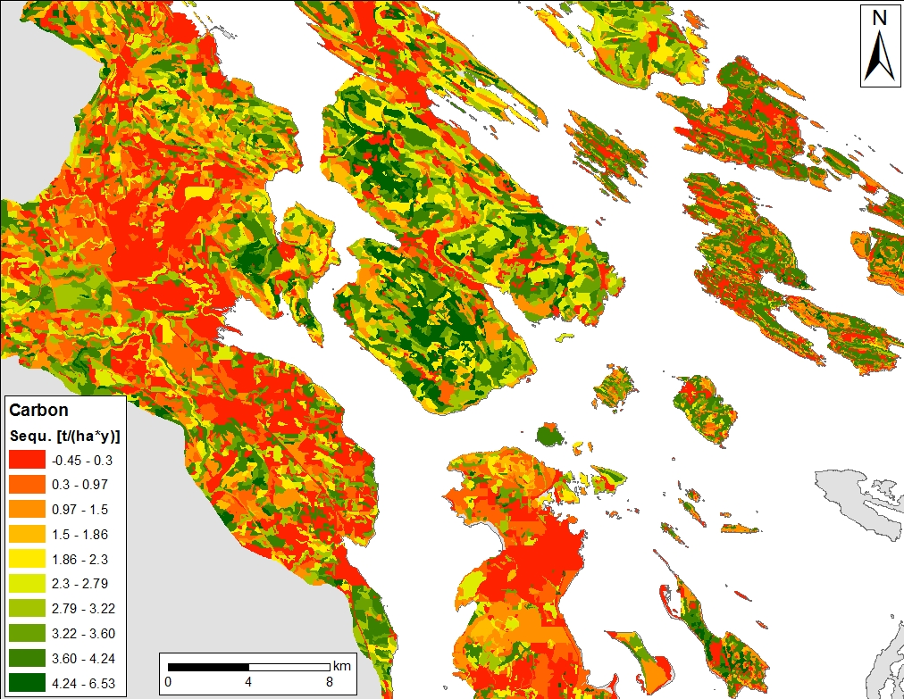
Synergies: High Value Forests Are Often Adjacent to Younger Forest With High Sequestration
High Sequestration Rates in Young Forest May Facilitate Landscape Level Planning

Slide 15
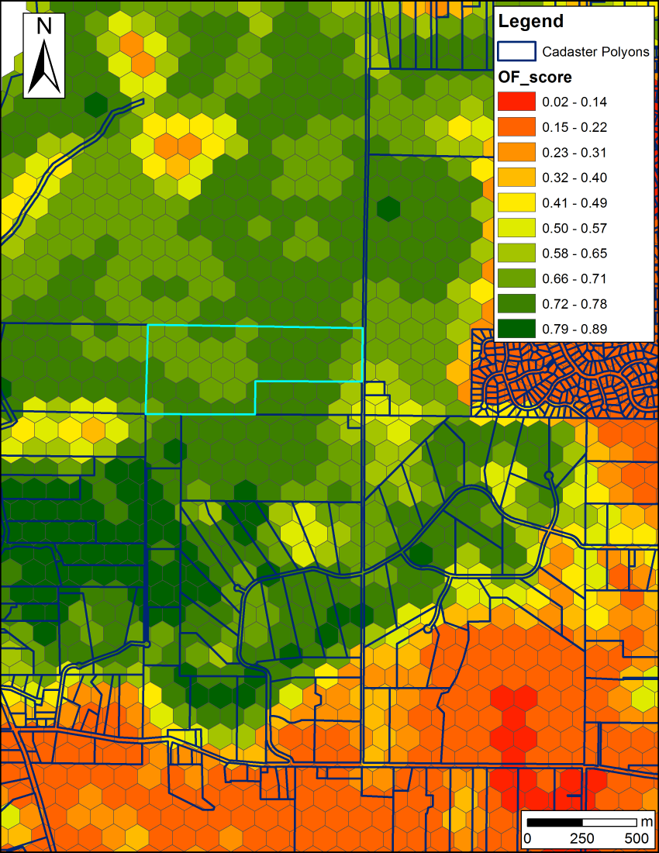
Biodiversity – Carbon Synergy in the Conservation of Forested Land
Biodiversity features
β-diversity of Old Forest and Savanna Bird Communities
Carbon budget model
Standing Carbon
Sequestration potential
Cost metrics used:
Total Land Value (TLV)
TLV – Standing Carbon * $/t
TLV – Sequestration Potential (20a) * $/t
TVL – Stand. Carb *$/t – Sequ. Pot. * $/t
$/t presented: 12.5 (average cost payed by Pacific Carbon Trust)

Slide 16
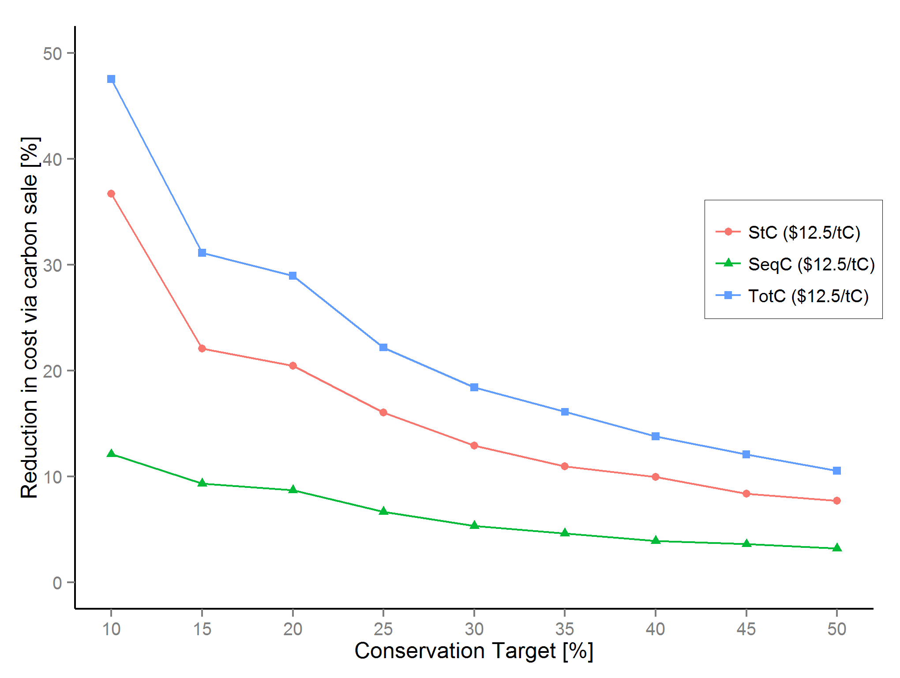
Biodiversity - Carbon
Huge Initial Reductions in Cost Possible
Schuster, Martin & Arcese 2014 PLoS One

Slide 17
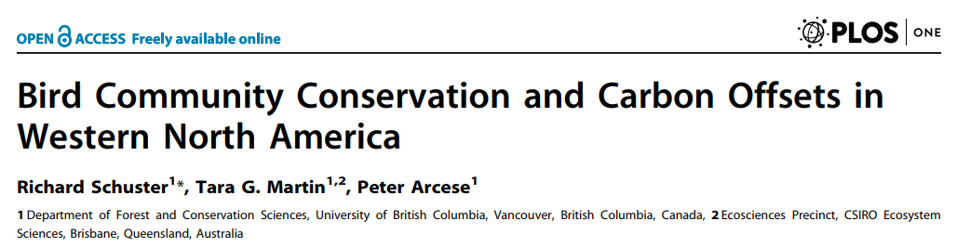
Exercise 4: Biodiversity – Carbon Synergy in the Conservation of Forested Land
https://www.richard-schuster.com/ILP/

